Slide 1

Improving Text Extraction Accuracy with Image Preprocessing
Under the guidance of Dr. T. Sridevi
BE2102-07
1601 18 733 067
1601 18 733 081

Slide 2
Agenda
The Problem
Solution Proposal
References

Slide 3
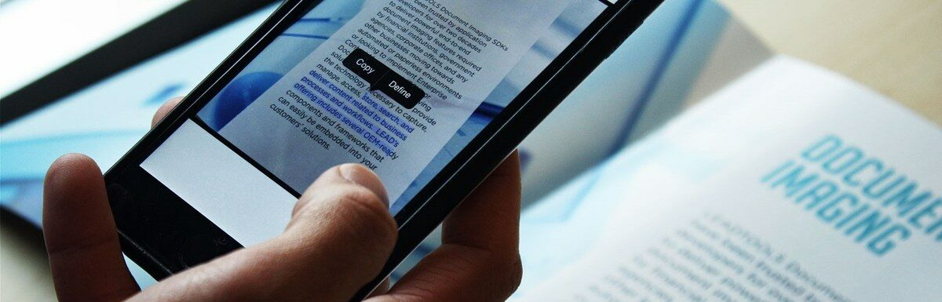
We often take images of Receipts or Invoices, Identity Cards, Books, and nutritional labels to save a copy of their details. This can be taken a step further by automating the process of information extraction and documentation.
Advancements in computer vision have paved the way to create tools for text detection and extraction.

Slide 4
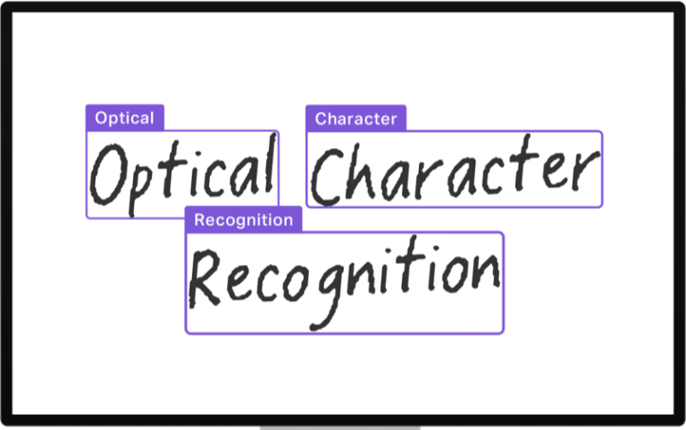
Optical Character Recognition(OCR) is used to recognize printed text in paper documents, handwritten characters, and text elements in the physical environment, such as license plate numbers, street signs, and street numbers.
Used in manufacturing and retail companies to digitize invoices, receipts and purchase orders to track overpayments, duplicate payments, price or quantity mismatch, etc
Used in banking industry to archive customer’s paperwork, account number etc leading to enhanced user experience

Slide 5

The Tesseract Project
Optical Character Recognition Engine, released under the Apache license as a free software.
Can detect over 100 languages and process right-to-left text.
Uses pattern matching technique.
Developed by Hewlett-Packard and currently maintained by Google.

Slide 6





Existing Tools in the Market

Slide 7







Traditional Optical Character Recognition
Document
Scan
Scanned Image File
OCR
Text Document

Slide 8
The Problem with Traditional OCR Methodology

Slide 9
Historical OCR engines have their accuracy lying between 70-80% for a high quality image at the page level.
That means in a page of 100 words 70-80 words are accurate.
While this might seem high, it can cause significant inaccuracies if used on a large volume of sensitive documents.

Slide 10
How can we increase the existing accuracy?

Slide 11
Image Preprocessing

Slide 12
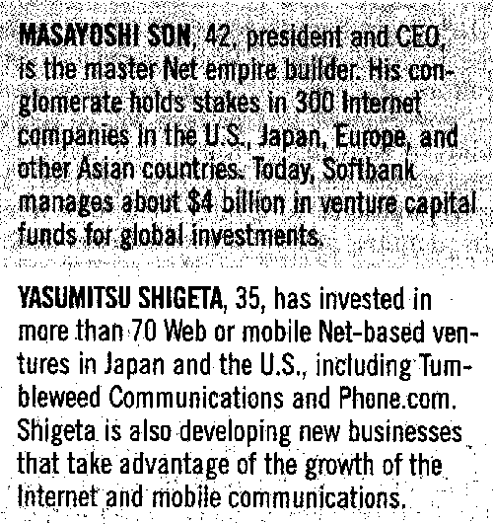
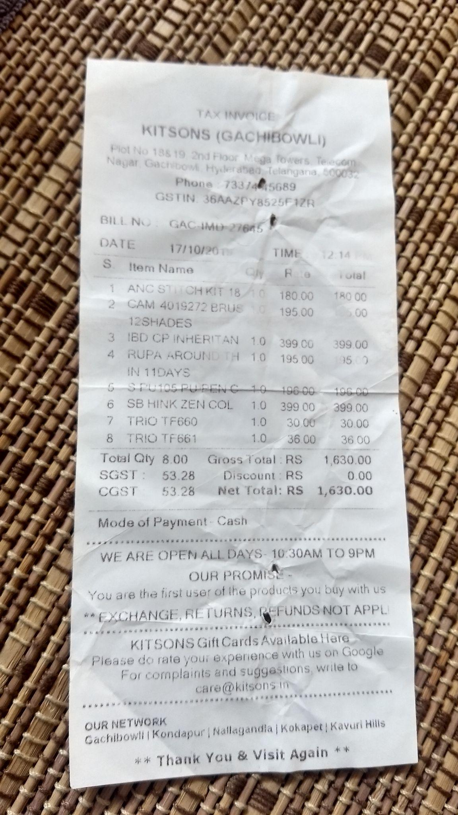
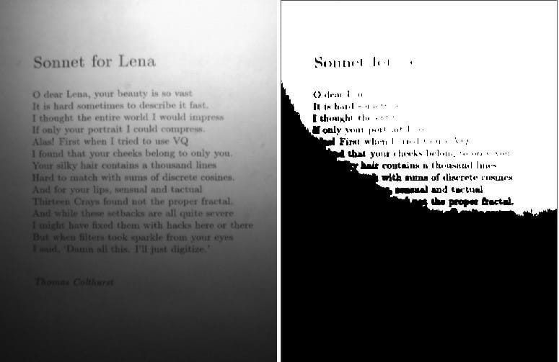
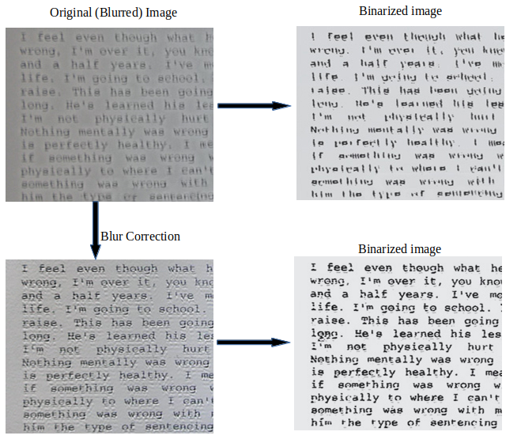
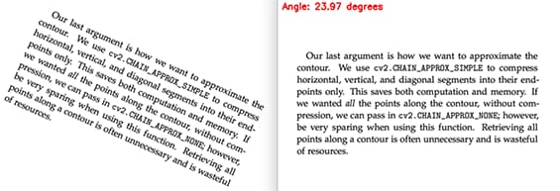

Slide 13
Pre-processing Techniques
Brightness Correction
Contour Detection
Scaling of Image
Skewness Correction
Noise Removal
Binarization

Slide 14
Solution

Slide 15

Document
Scan
Scanned Image File Upload
Text Document
Image Preprocessing Pipeline
OCR

Slide 17

70%
to
~90%

Slide 18
Who will be using it?

Slide 19
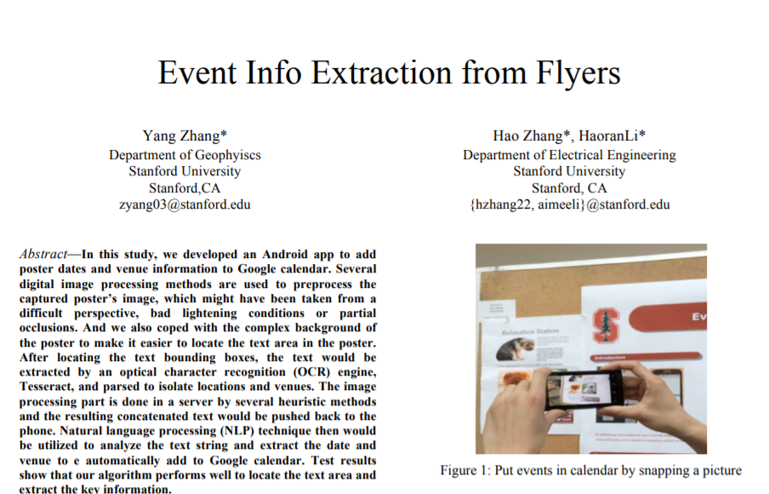
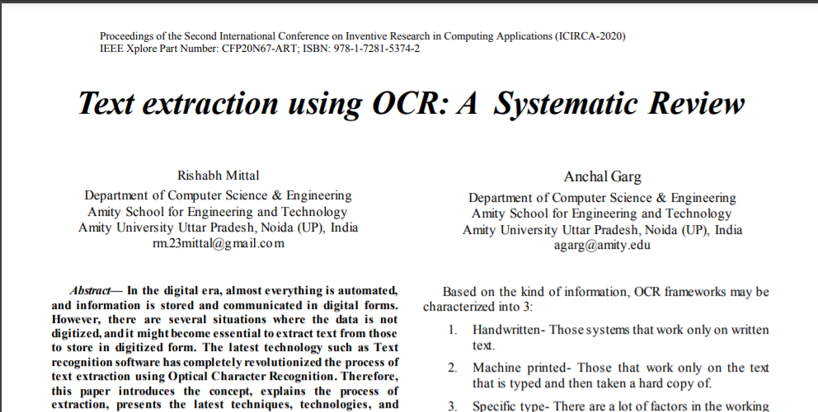
References

Slide 20
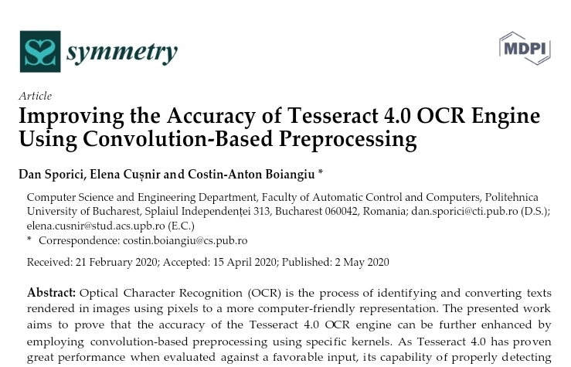
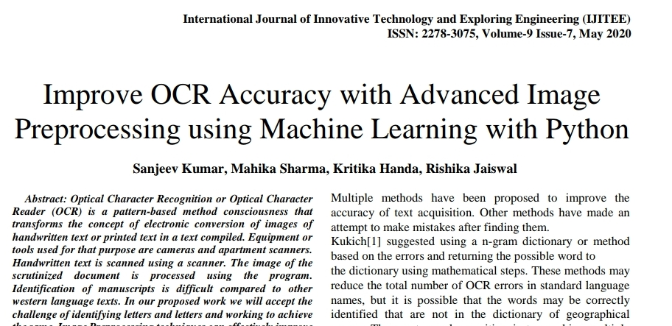
References

Slide 21
Thank you

